Slide 1
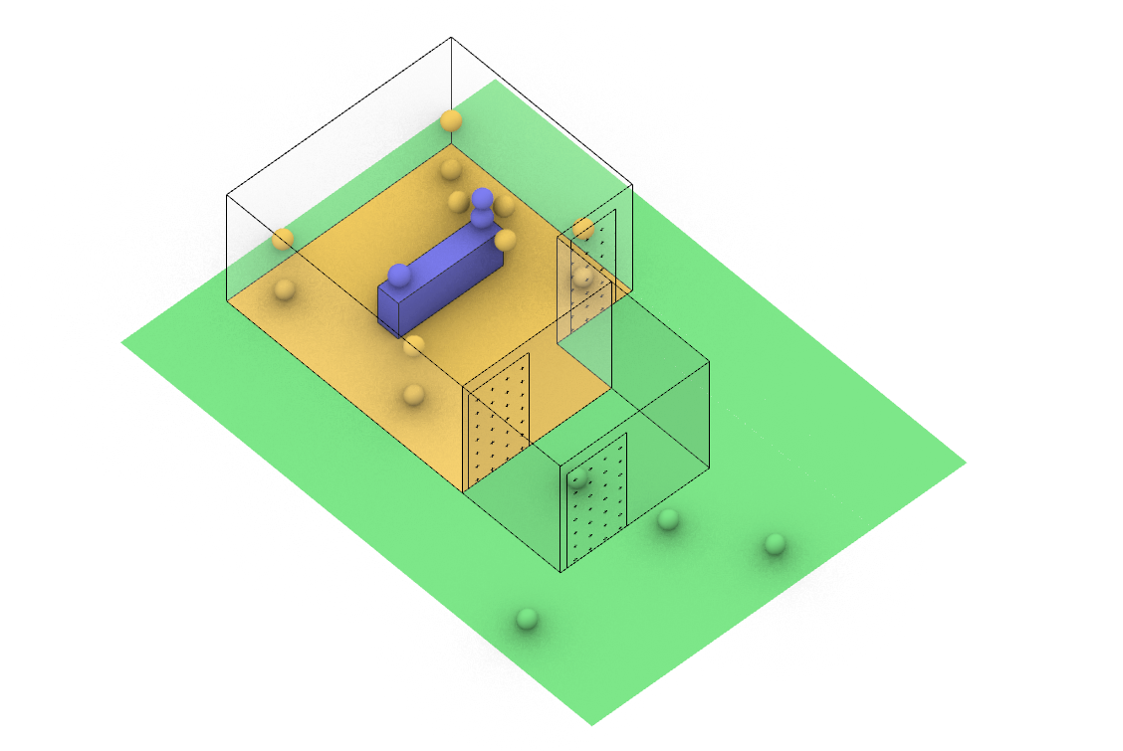
Aerosol Source
Periphery
Outside

